Slide 1

Hmoney Version 1.1
Payroll System for the Startups and Small Businesses

Slide 2
Group names and roles
Ivan Avalos
Admin Front and Back end
Presentation, and SRS documentation
Updated Part Timers Handling
Chris Pipitone
Group leader
Presentation and Employee Front and Back end
General troubleshooting and error handling
Added New DataBase Functionality
Zhuowei Hu
Built the database, Managed the Payroll algorithm, How-to Manual
Managed our interactions with github
General troubleshooting and error handling
Updated Tax and Gross Pay
Patrick Chu
Worked on Update and Remove Employee
Updated SRS and Users Manual
Haftamu Molla
HR Front and Back end, Benefits implementation
Presentation and SRS documentation
Updated Security

Slide 3
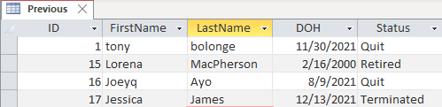

New DataBase For Previous Employees
This new database stores previous employees who have left the company for reasons that can be selected from the program
Only Relevant Information about the employee is stored here

Slide 4
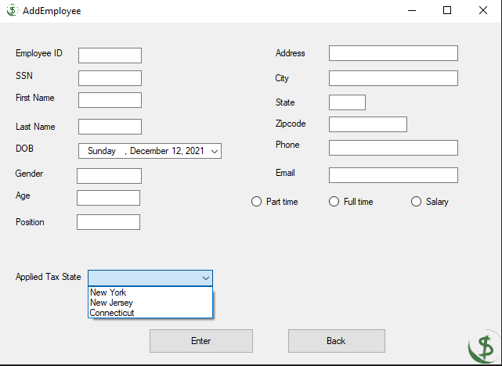
For HR - Add Employee Window
Added new options for different states!
Added new options for different earnings types!

Slide 5
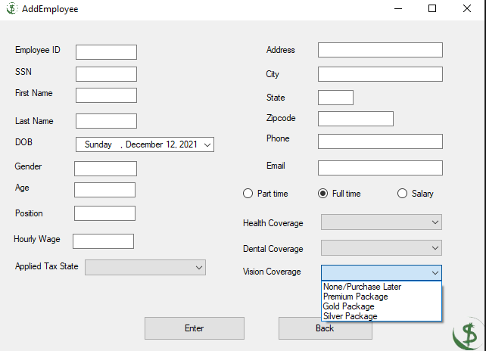
For HR - Add Employee Window
Added new options for different earnings types!

Slide 6
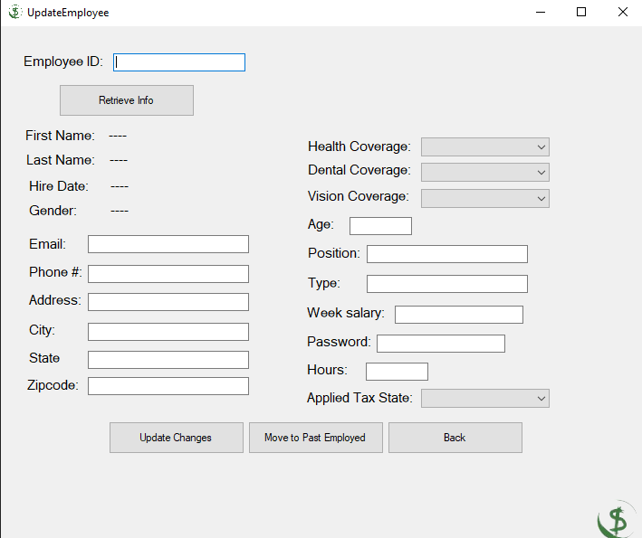
For HR - Update/Remove Employee Window
Record
HR can edit Employee information and update to the database.
Update useful information
Change Employee Benefit Package!
Added New Database Functionality!

Slide 7
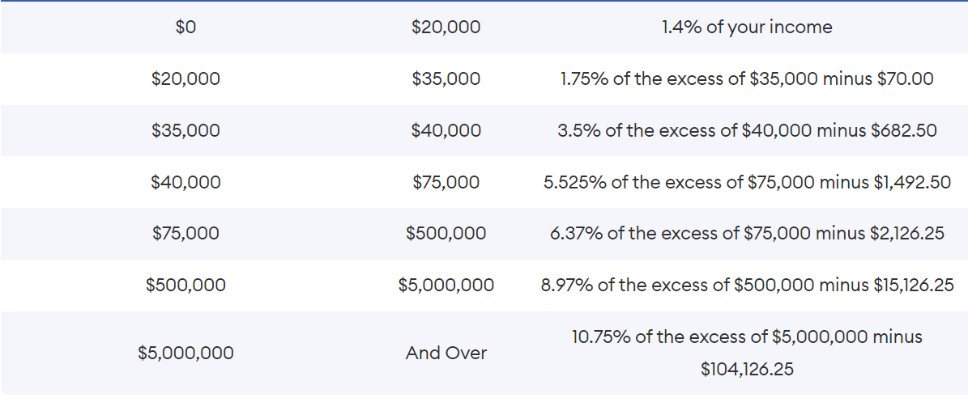
New Jersey Taxes

Slide 8
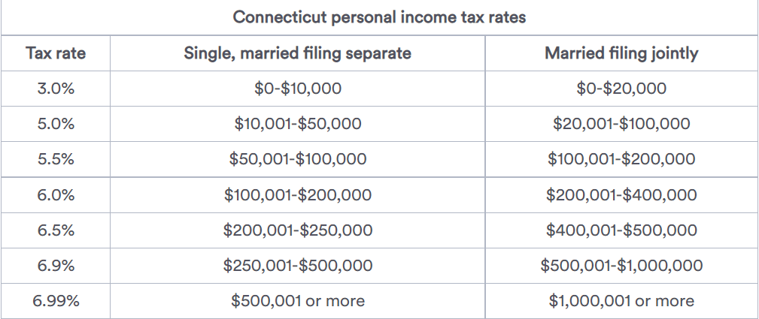
Connecticut Taxes

Slide 9
401k benefit
401k will take 4.3% of the salary
The 4.3% will be not taxed
You won't pay income tax on 401(k) money until you withdraw it.

Slide 10
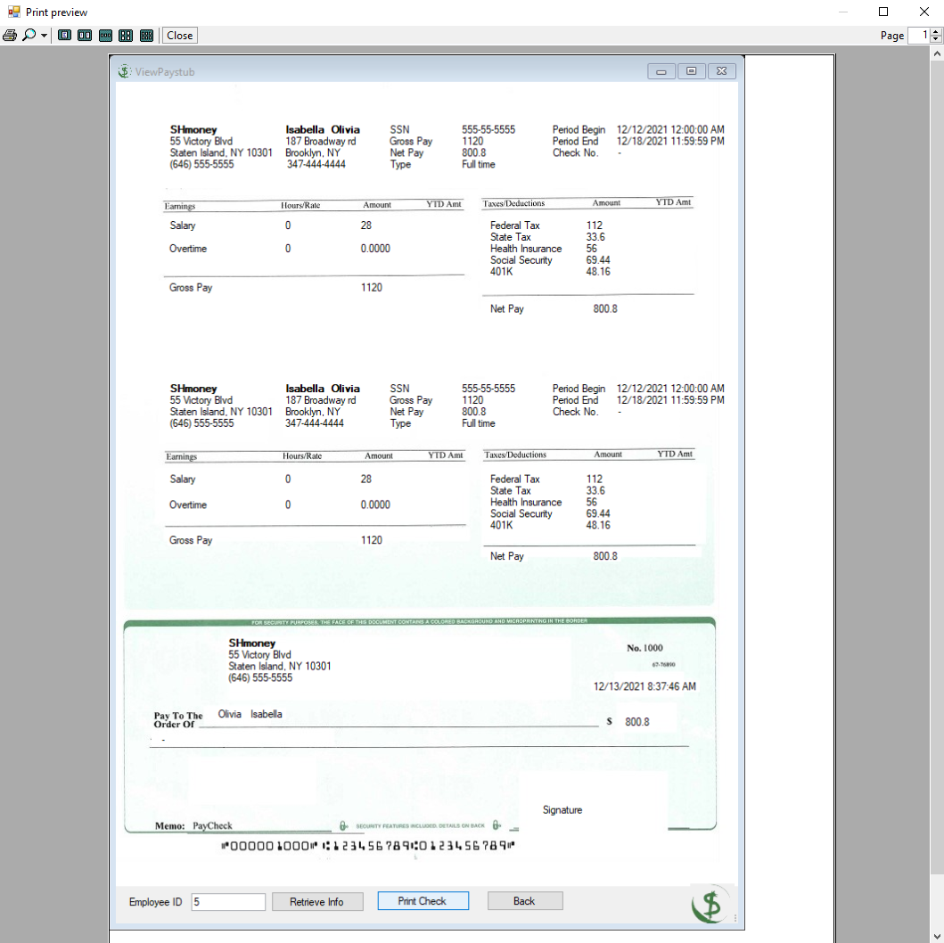
Printing Option
Give the user the option to print their check

Slide 11
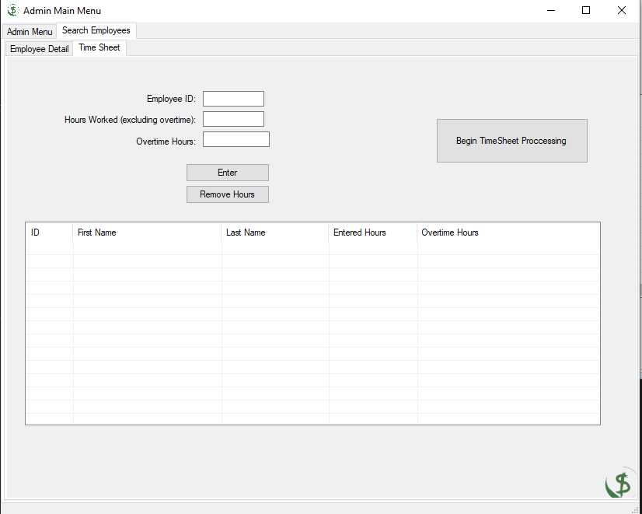
For Admin- New System to Enter Employee Hours
Streamlined process that enables users to quickly and accurately enter their employees Hours

Slide 12
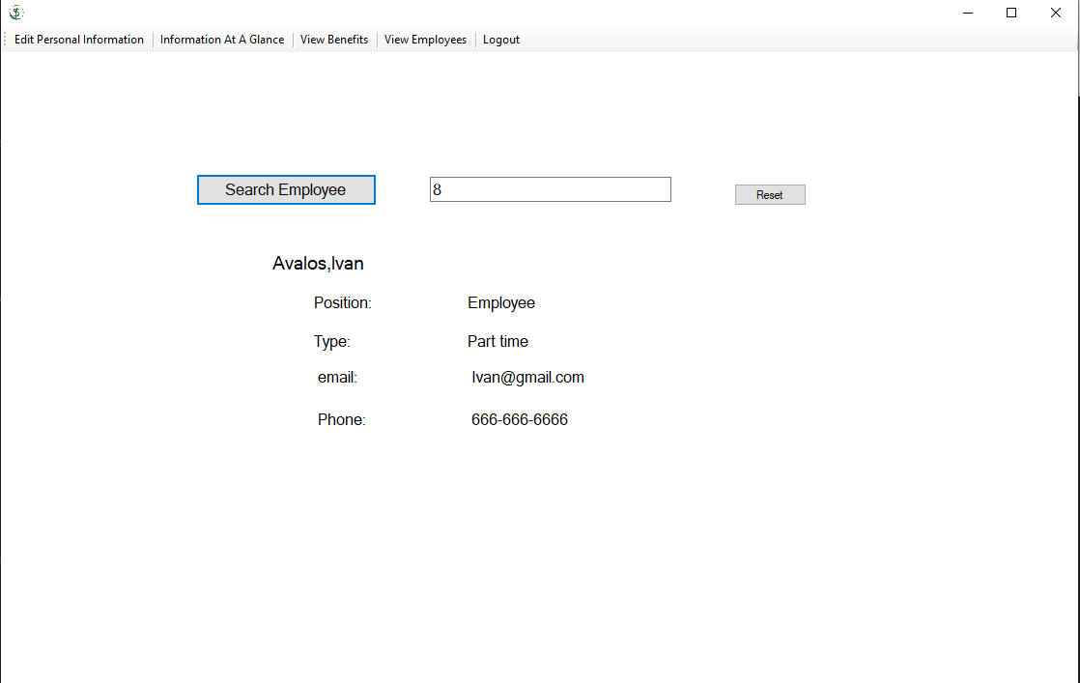
Coworker Search
Added A Method for employees to search fellow employees contact information!

Slide 13
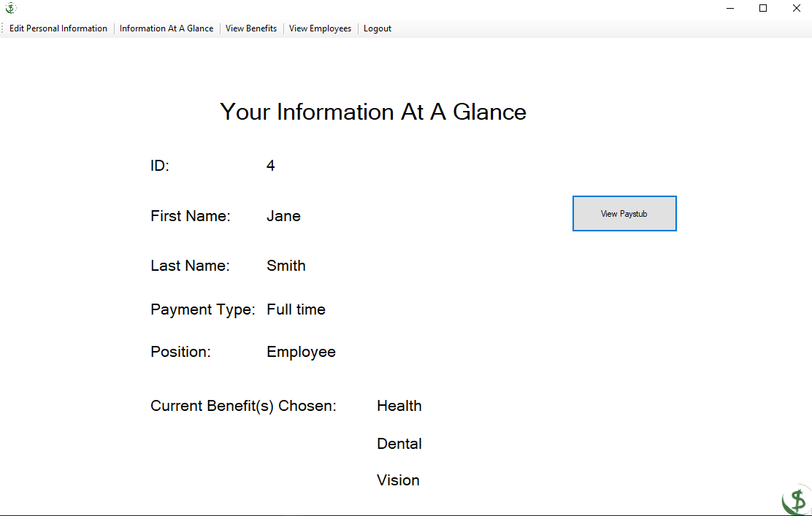
View Your own Pay stub!
Employee users can now quickly view their most recent pay stub within their home menu

Slide 14
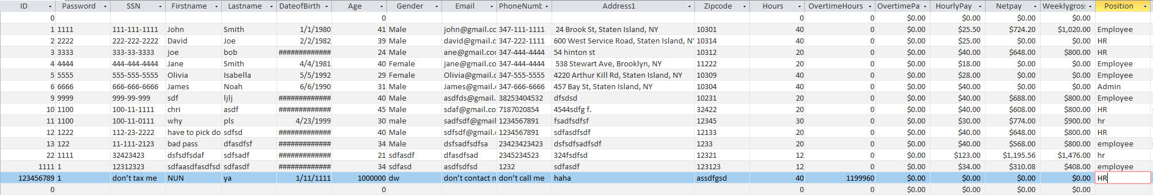
Known Errors and Corrections!
Input’s with improper data formatting are now not accepted
HR users can still input incorrect dates of hire or contact information however it can be updated at a later date

